Slide 1
Project 1 Resturant WebApi

Slide 2
Technologies Used
Visual Studio
ADO.Net
MSSql Server
Serilog
Swagger
.NetCore

Slide 3
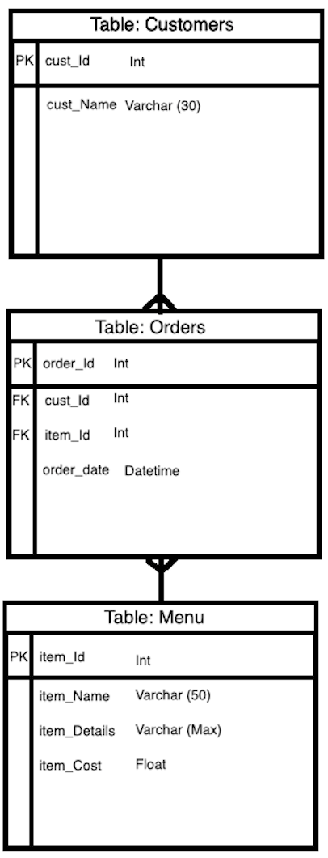
Entity Relationship Diagram

Slide 4
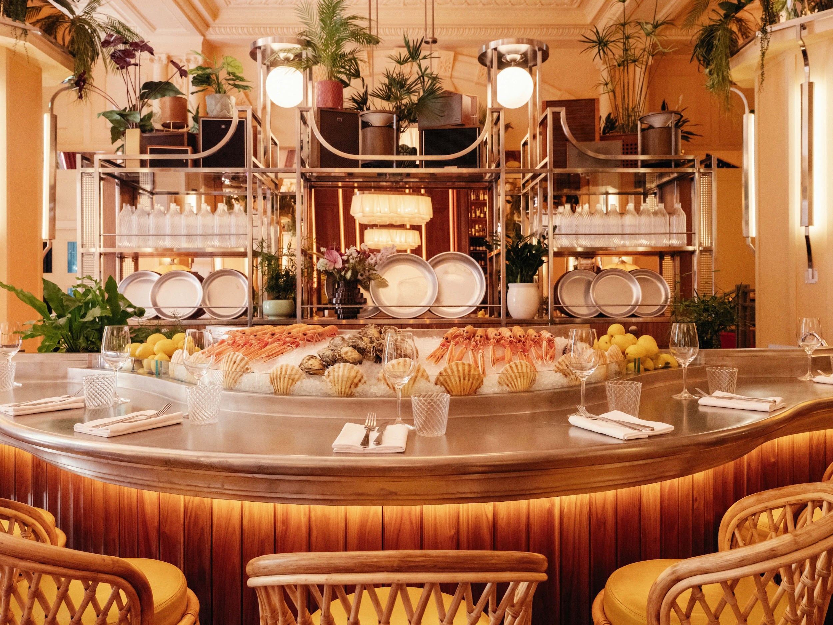
Costal.
The Resturant by the sea

Slide 5
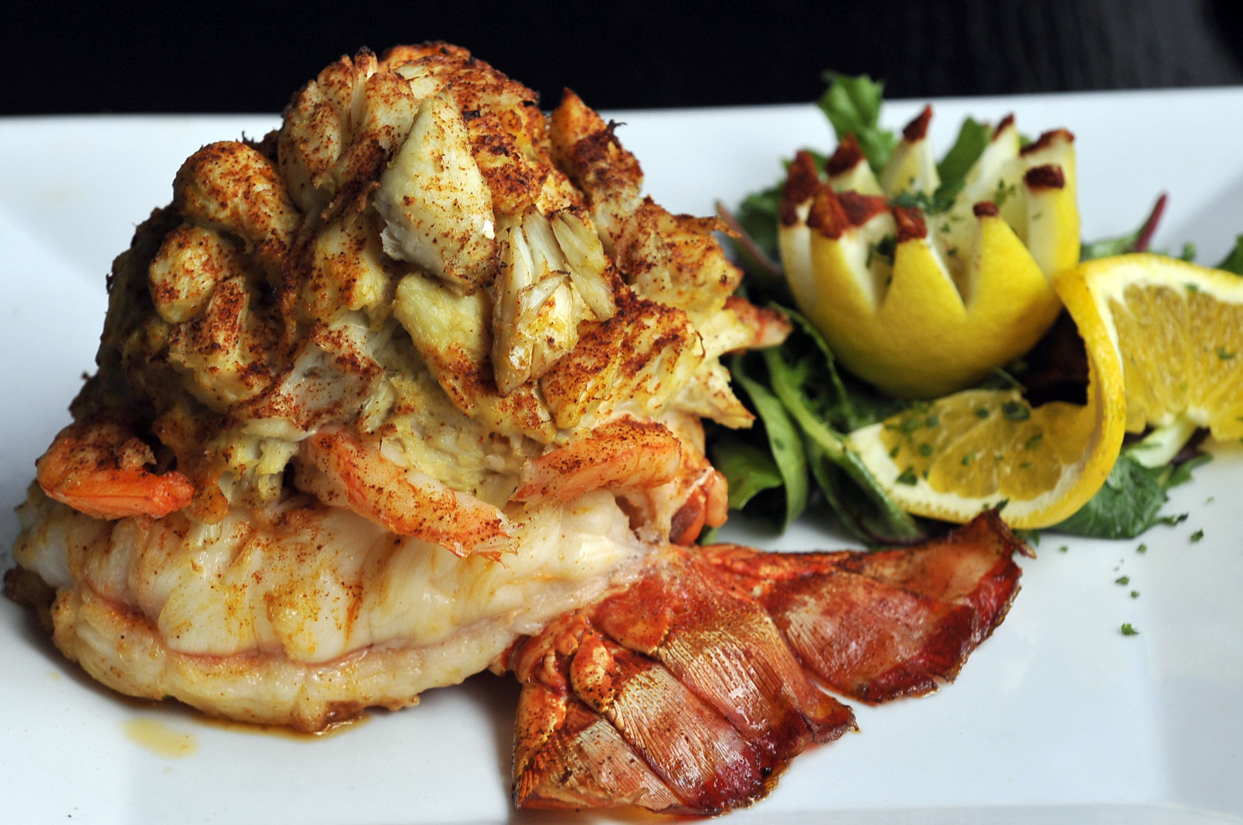
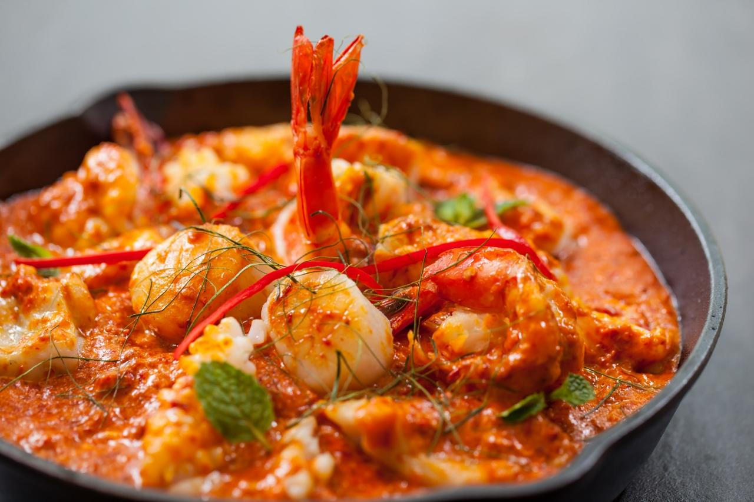
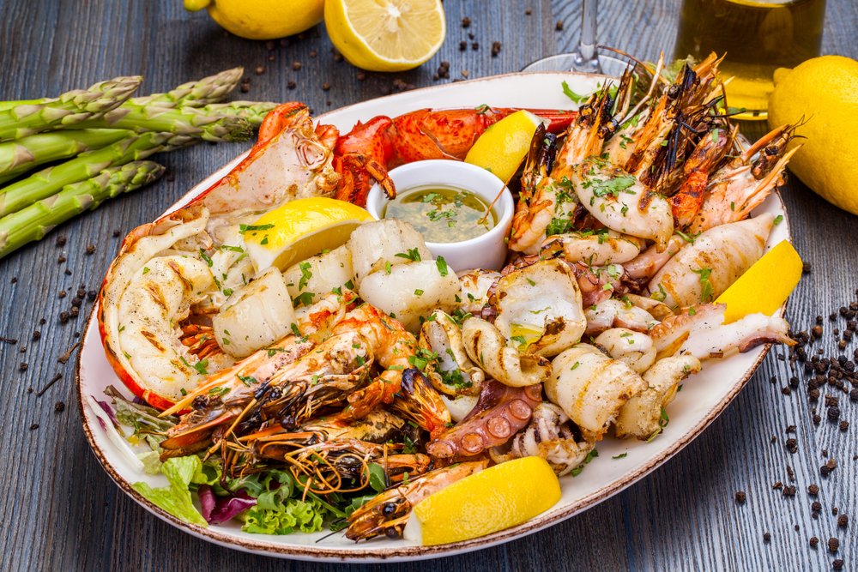
Menu
#200. AppleWood Smoked Salmon $23.05
House smoked king salmon with toasted onion rye focaccia chips
#202. Pacific Calamari $17.55
A large plate of crispy calamari with a spicy jalapeno garlic aioli dip and marinara sauce
#204. Costa Rican Mahi & Crab $29.89
Pan grilled mahi, lump crab, light lemon butter & buttered Yukon gold potatoes
#206. Lobster Macaroni & Cheese $22.12
Gruyere, Irish Cheddar, and Cotija cheese, bay shrimp and chunks of Maine lobster baked with heavy cream and penne pasta
#208. Smoked Duck Rolled Tacos $18.34
Smoked duck pulled and rolled into our house made corn tortillas, 3 Rolls
#210. Roasted Oysters $21.21
House oysters roasted over maple chips
#212. Blackened Shrimp $19.22
Flash grilled shrimp in cajun spices
#214. Seafood Pasta $23.11
Fresh shrimp, crab meat and peas tossed in Alfredo sauce over three cheese tortellini
#216. Crab Stuffed Lobster Tail $34.67
Grilled lobster tail stuffed with king crab finished with a garlic butter drizzle

Slide 6
Future Improvements
Diversify the menu
Gather more information in the customers table
Add coupons/discounts (maybe age related)
Filter the serilog
Add qty
Order Adjustments
More Validations
Pending orders

